Slide 1
Competitor Article Presentation
By Joanna Riascos

Slide 2
Parking Issues
Not only is looking for a parking space time consuming, it is also very stressful and tiresome.
While drivers continue looking for parking spaces there is a greater exposure of car emissions.
Car emissions are one of the major contributors of air pollution.

Slide 3
Air Pollution Effects
Health Risks
Environmental Effects
Respiratory diseases (bronchitis and permanent lung damage)
Increased risk of a heart attack
Irritation of the eyes
Birth effects on animals
Acid rain (big amount of nitric and sulfuric acids)
Eutrophication (blooms of algae)
Haze (sunlight encounters tiny pollutions in the air)

Slide 4
Expected Contribution
What can we do to help the environment?
What is a smart way to help reduce car emissions?
Can “smart parking” contribute in helping save the environment?

Slide 5
Smart Parking
Allows drivers to quickly find parking spots.
The “smart parking” system utilizes sensors to detect whether a parking space is vacant or not.

Slide 6
Smart Parking Benefits
Reduced air pollution
Better driver experience (less stress)
Less money spent on gasoline
Maximize revenue

Slide 7
State of the Art
The “smart parking” system has been implemented in the United States, United Kingdom, Europe, Japan, and India.
Ellicott City, MD was one of the cities that implemented the smart parking system.
According to the Los Angeles County, the smart parking system “resulted in saving 31.3 million hours of travel time, 38 million gallons of fuel and 337,000 metric tons of carbon dioxide per year.”

Slide 8
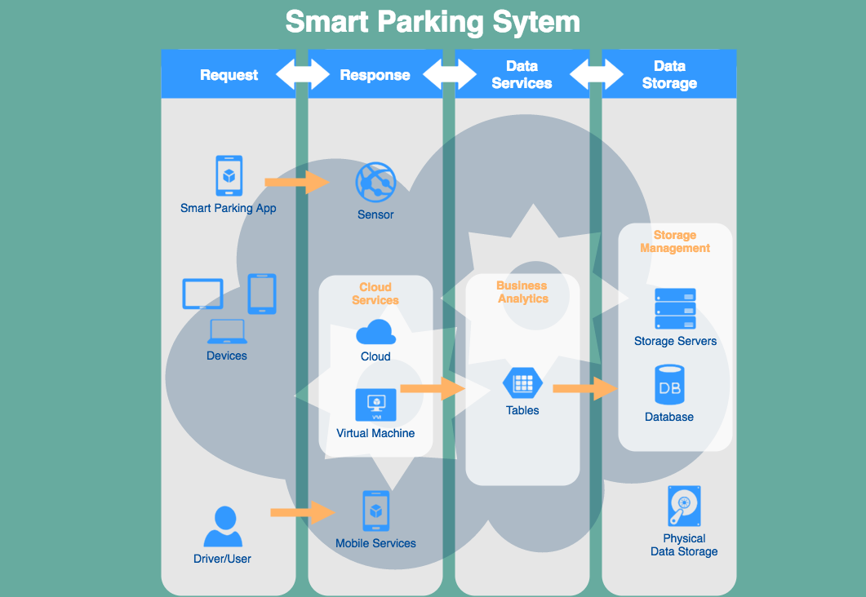
draw.io

Slide 9
Admin API
draw.io

Slide 10
User API
draw.io

Slide 11
System Data Center
draw.io

Slide 12
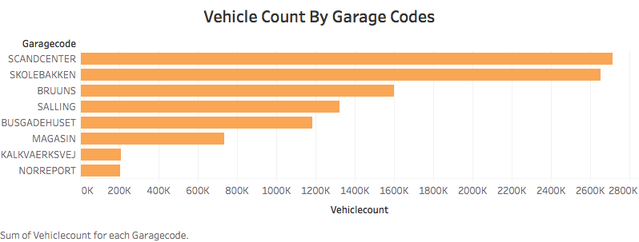
Tableau

Slide 13
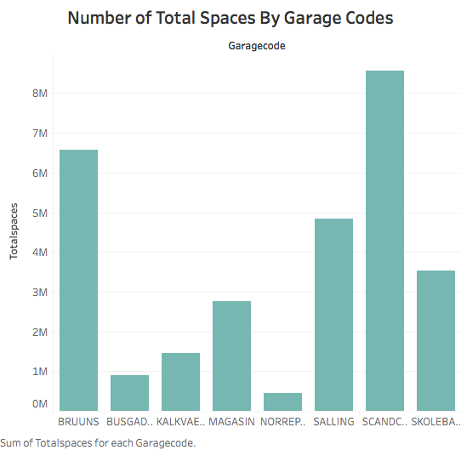
Tableau

Slide 14
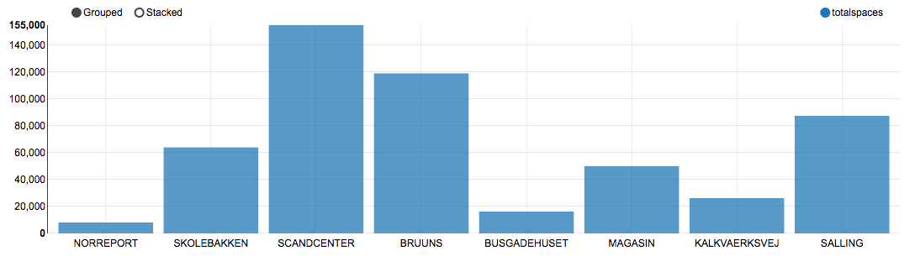
Sum of Total Spaces by Garage Codes
Zeppelin

Slide 15
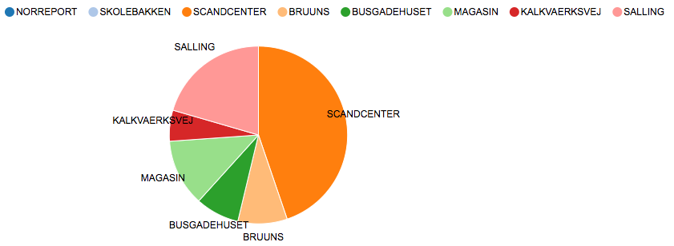
Sum of Vehicle Count by Garage Codes
Zeppelin

Slide 16
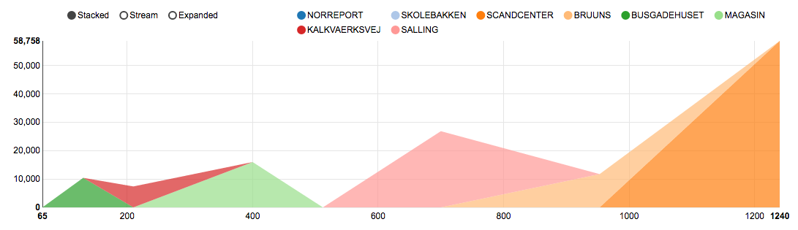
Vehicle Count and Count of Total Spaces by Garage Codes
Zeppelin

Slide 17
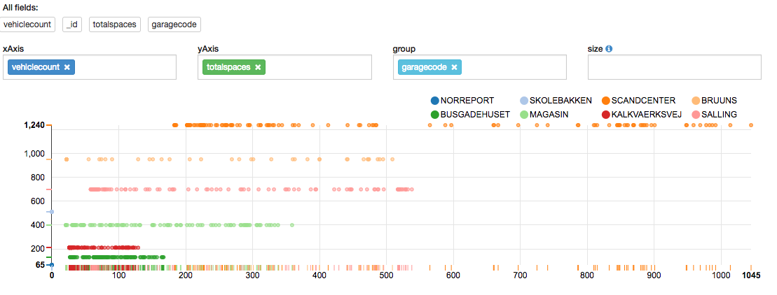
Vehicle Count and Count of Total Spaces by Garage Codes Scatter Plot

Slide 18
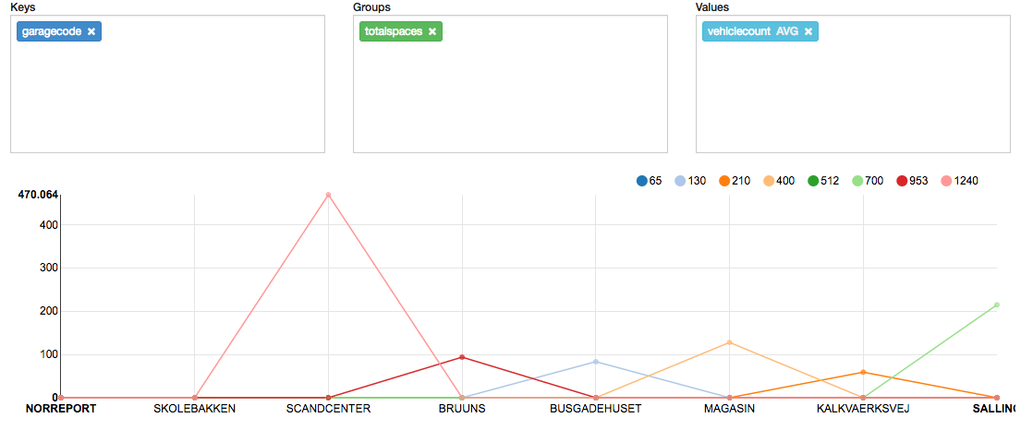
Avg of Vehicle Count Grouped by Count of Total Spaces

Slide 19
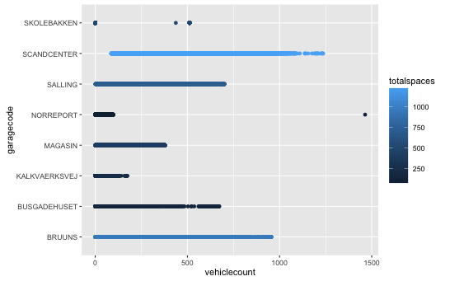
R Scatterplot
RStudio

Slide 20
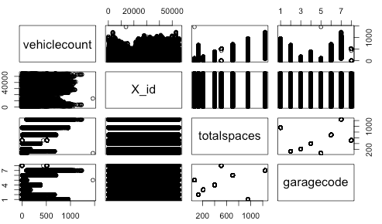
R Scatterplot Matrix
RStudio

Slide 21
Reference Article
ieeexplore.ieee.org/iel5/5888675/5928760/05928901.pdf
Smart Parking Reservation System By Mohit Patil and Rahul Sakore

